Slide 1


Slide 2
UNLOCKING INSIGHTS INTO THE GLOBAL AIR TRANSPORTATION NETWORK WITH TABLEAU

Slide 3
TEAM LEADER G. ILAYARANI B.SC., Physics Shree Raghavendra Arts and Science College

Slide 4
TEAM MEMBERS M. DHARSHINI B. DHIBAKAR T. HARITHA V. PURSHOTHAMAN B.Sc., Physics Shree Raghavendra Arts and Science college

Slide 5
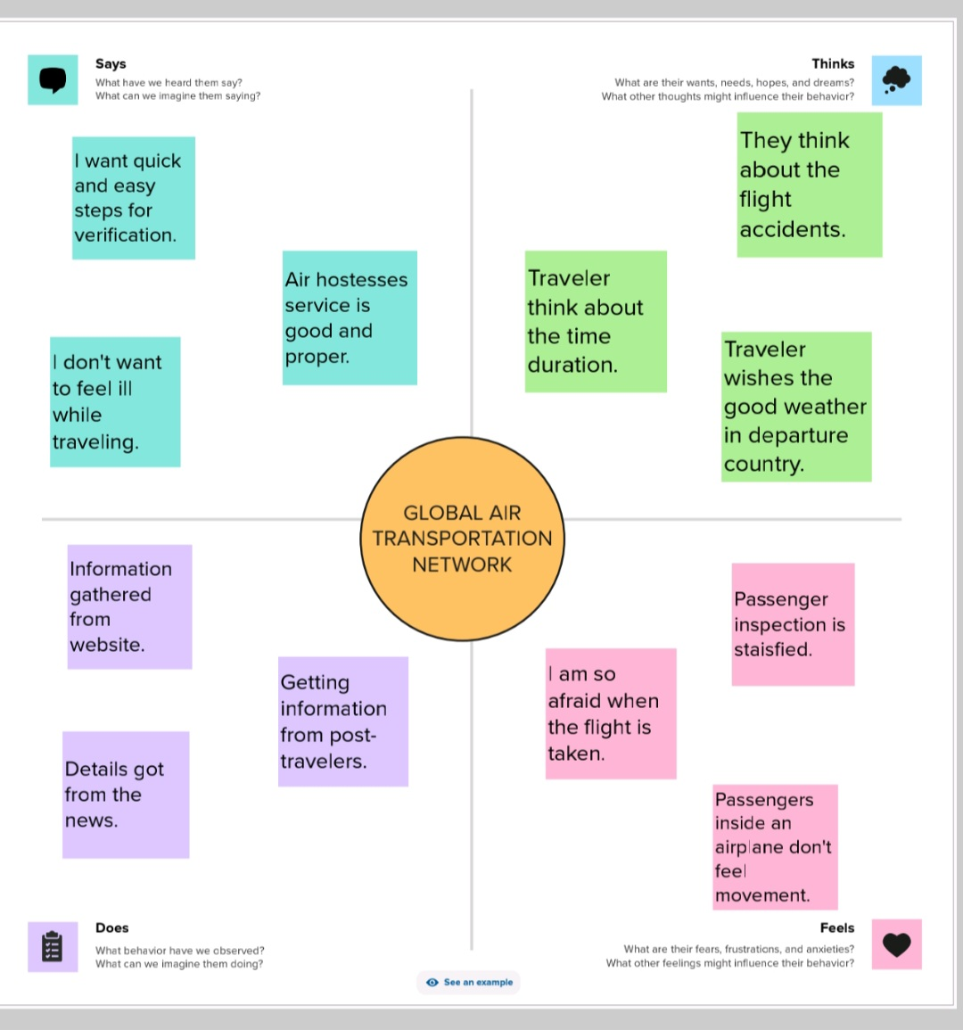
EMPATHY MAP

Slide 6
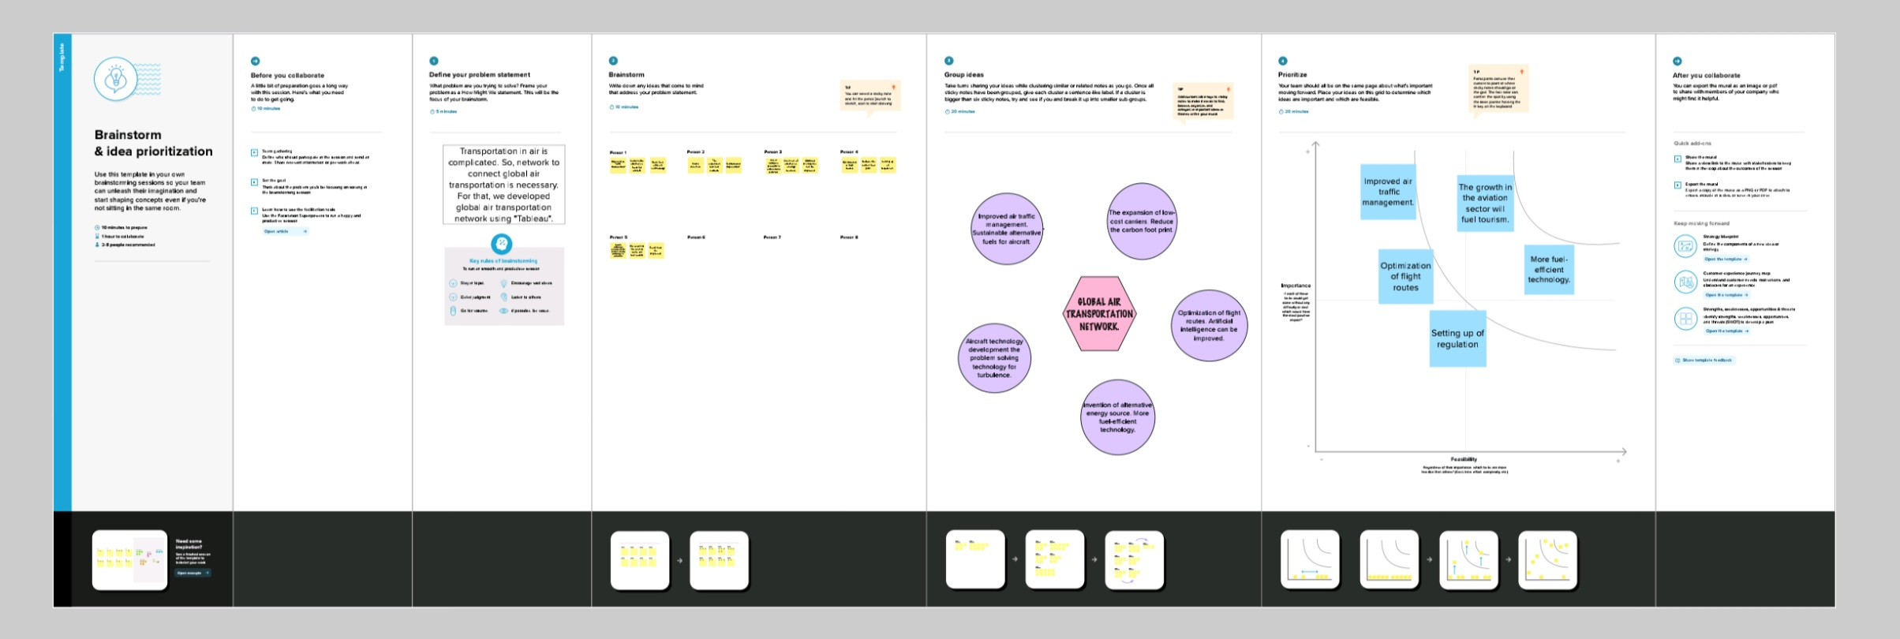
BRAINSTORMING MAP

Slide 7
5 SHEETS ABOUT THE PROJECT

Slide 8
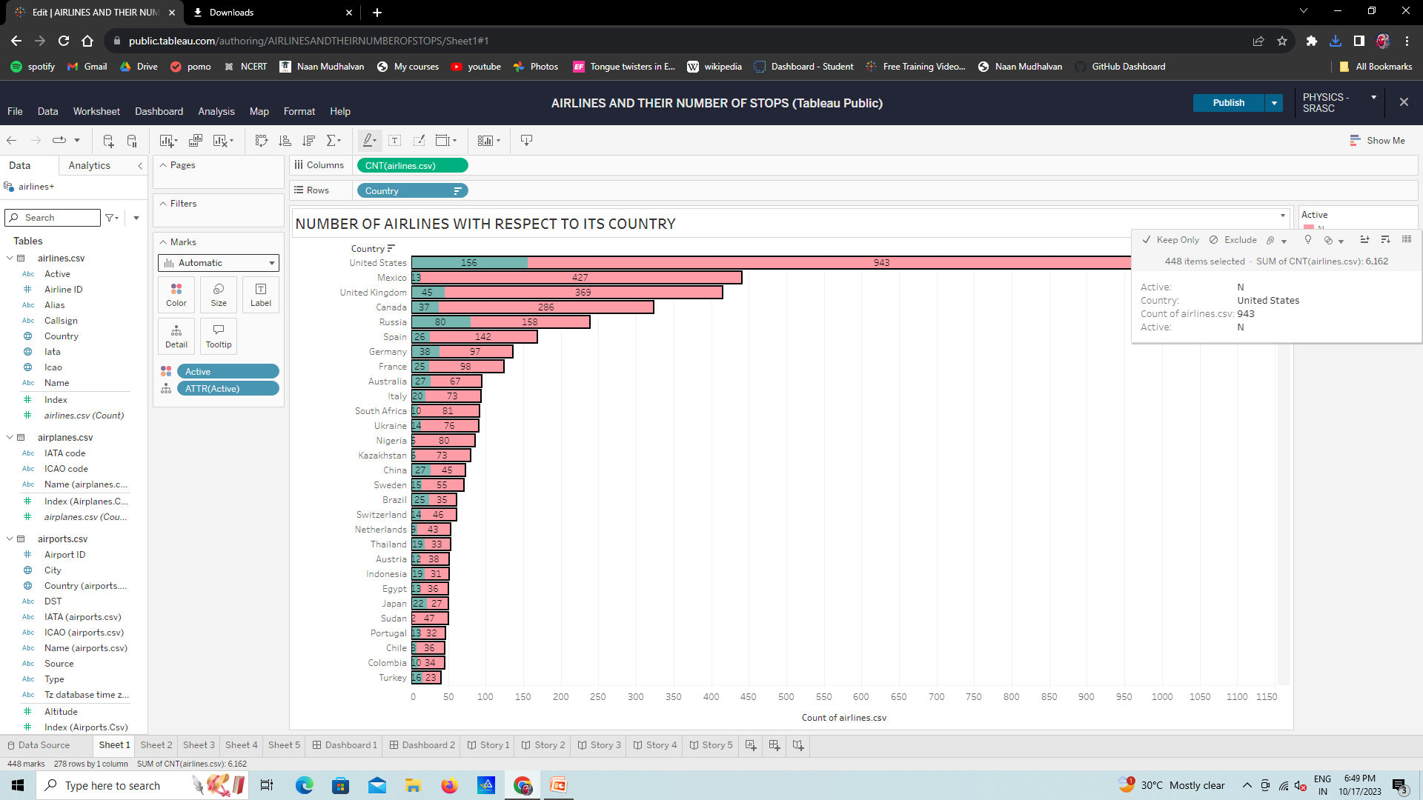

Slide 9
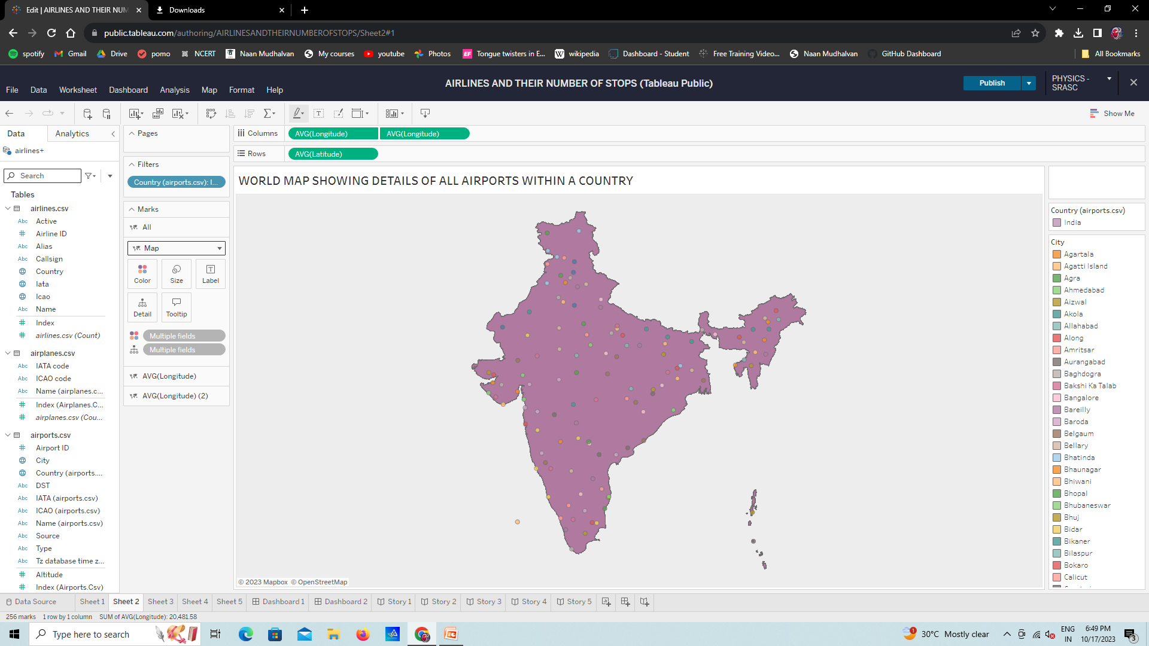

Slide 10
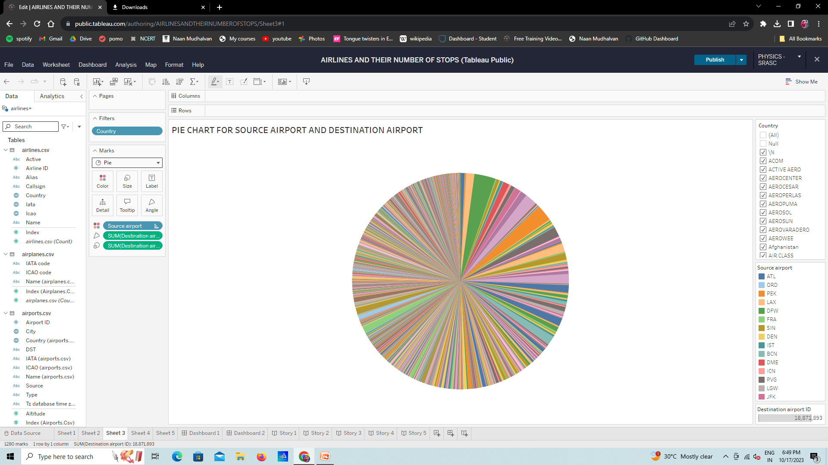

Slide 11
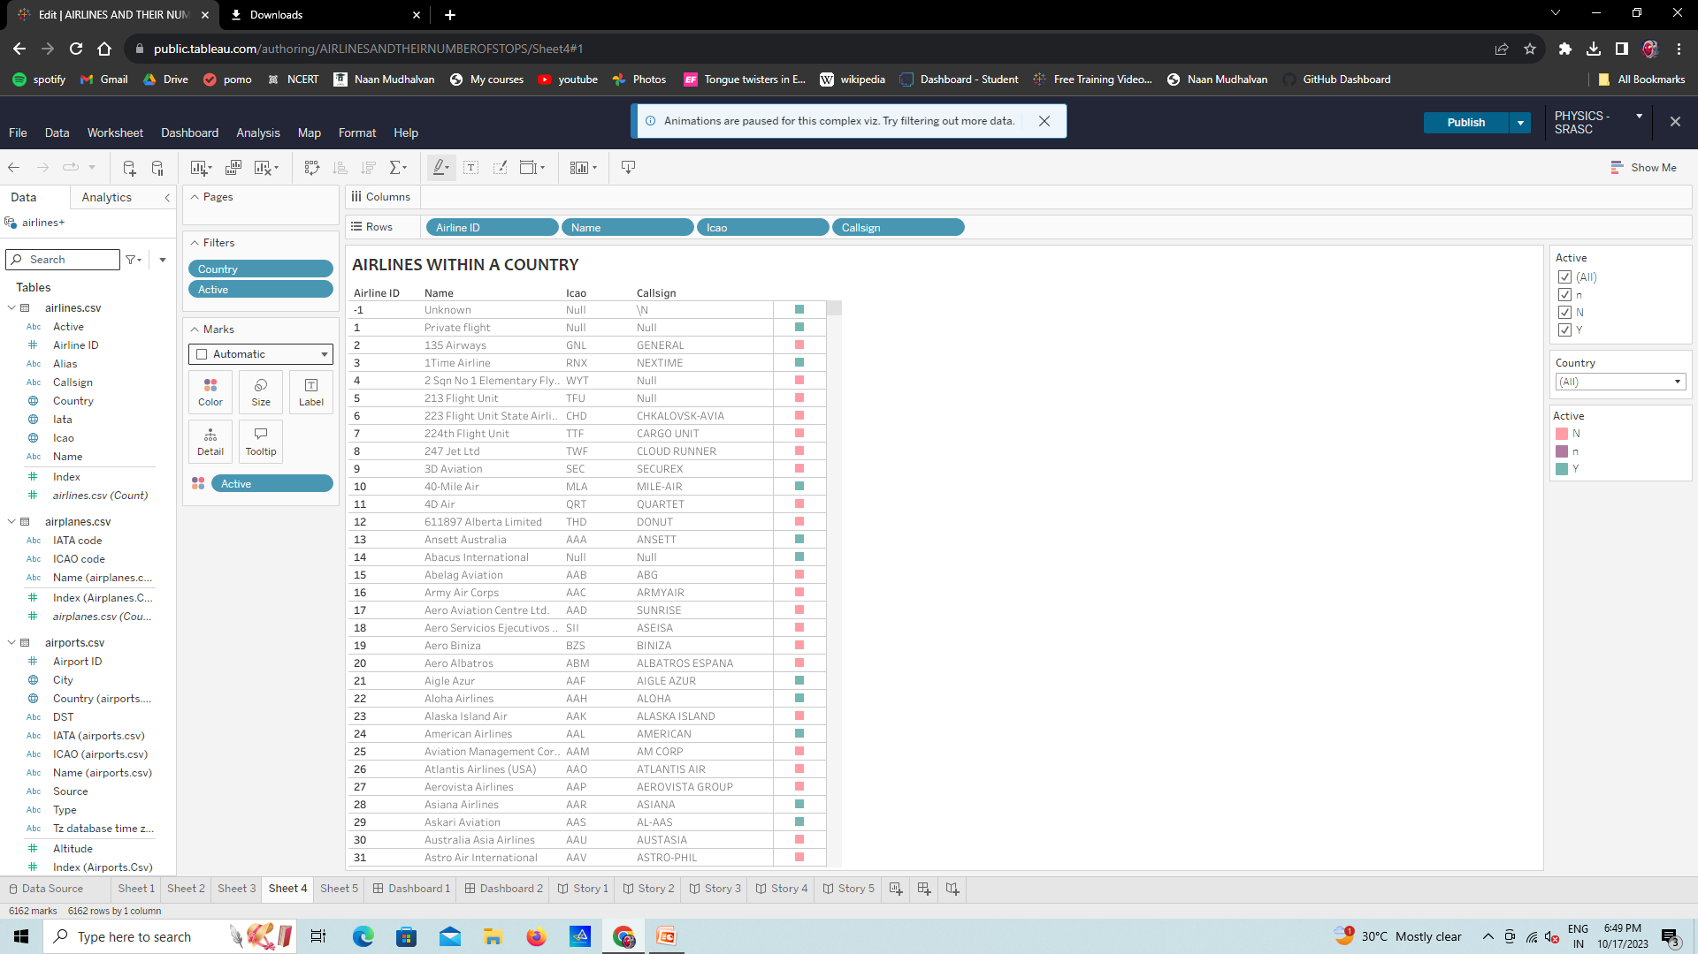

Slide 12
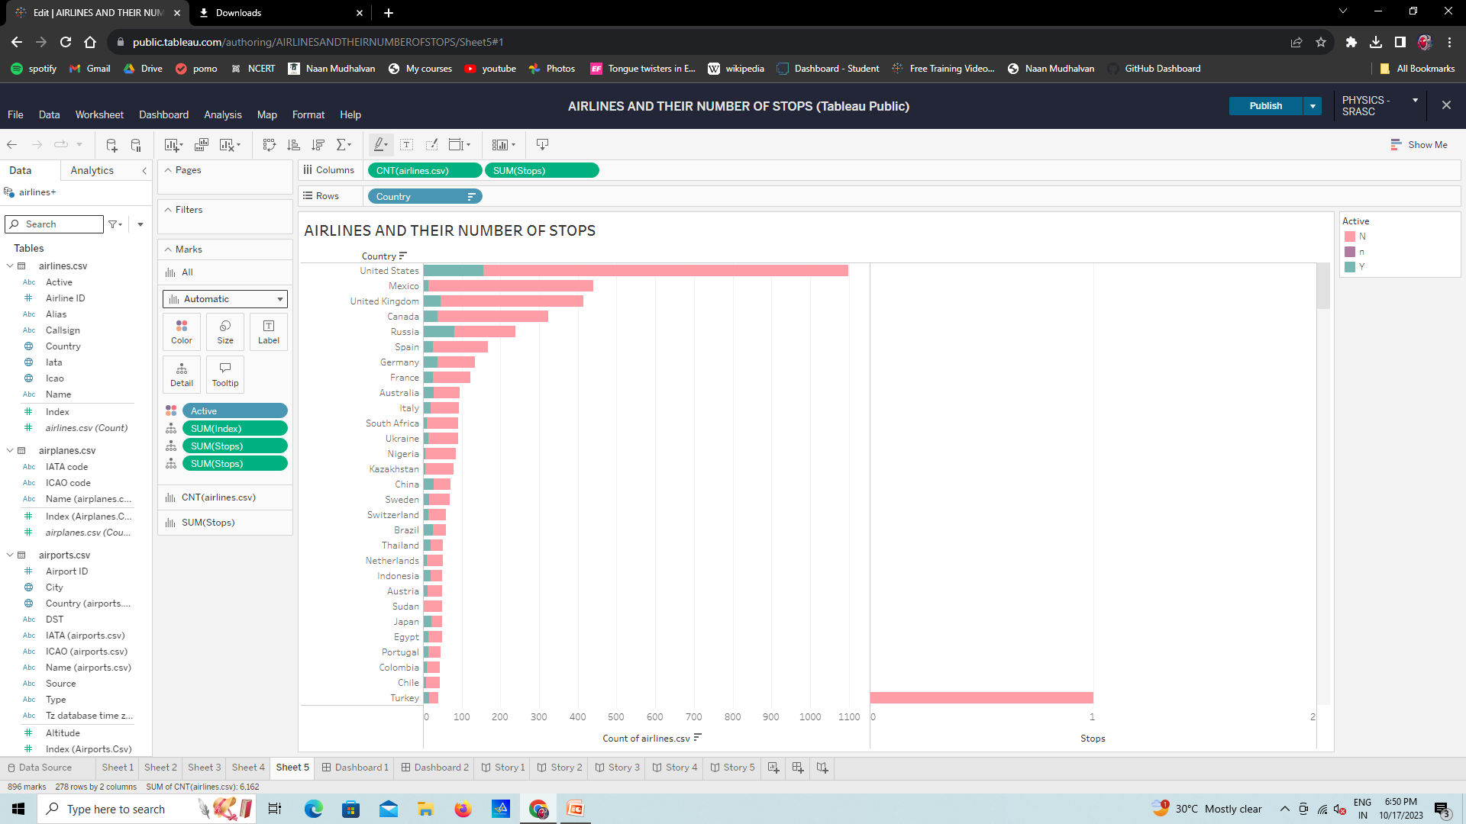

Slide 13
STORY FOR THE SHEETS

Slide 14
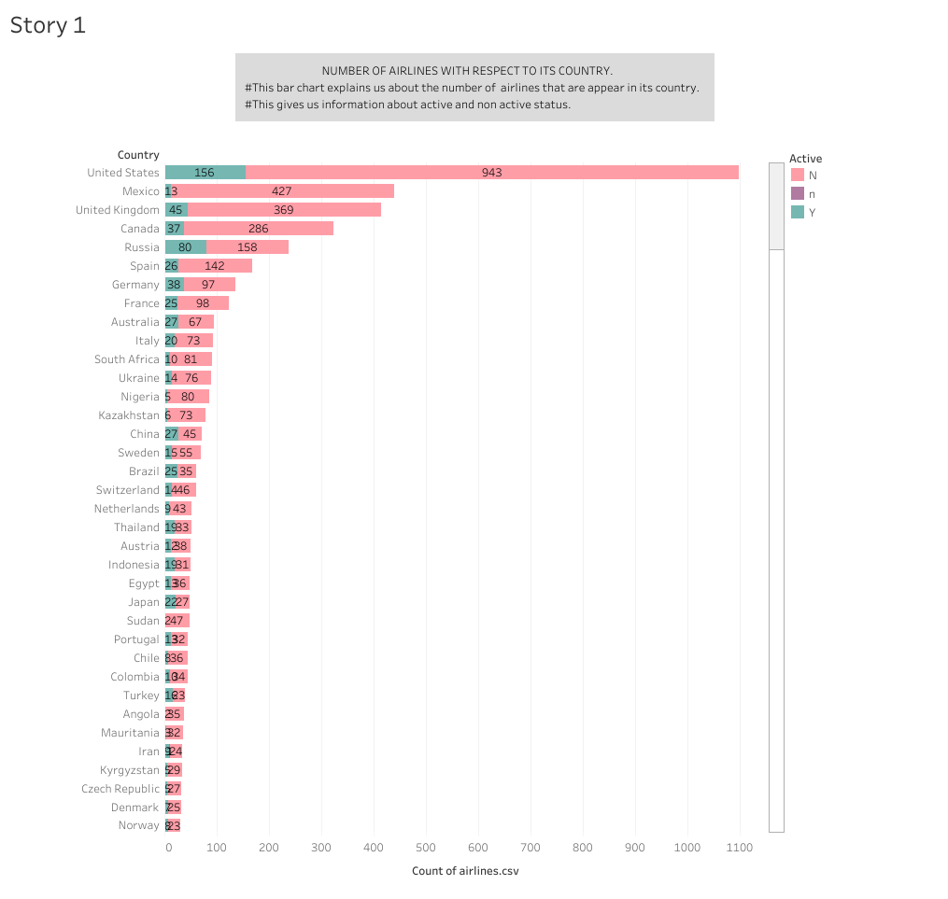

Slide 15
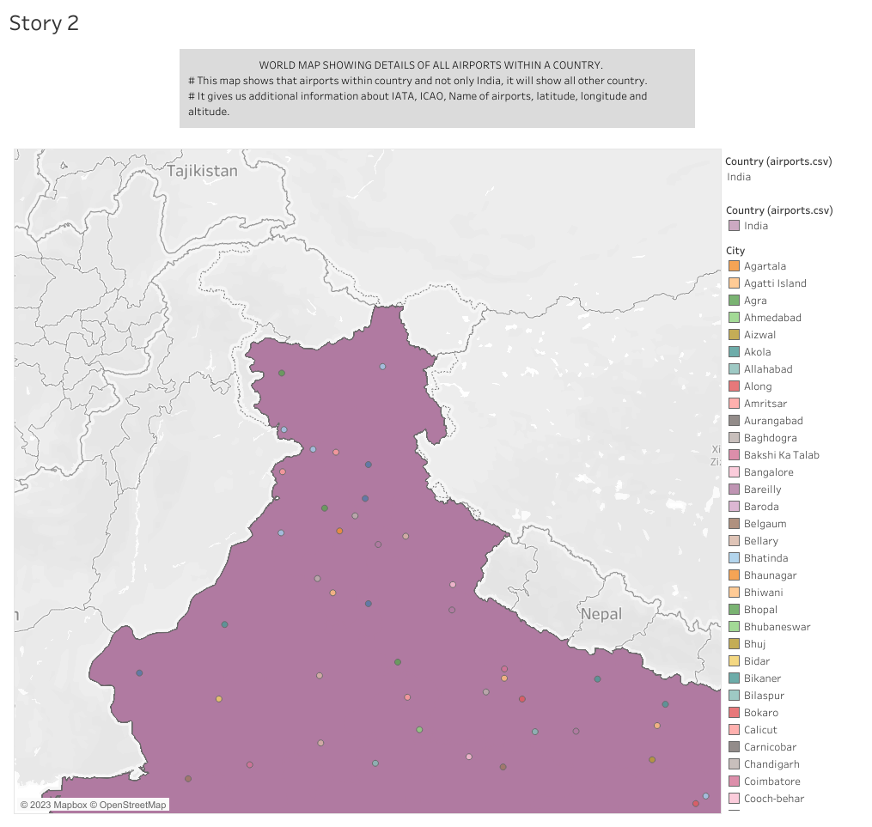

Slide 16
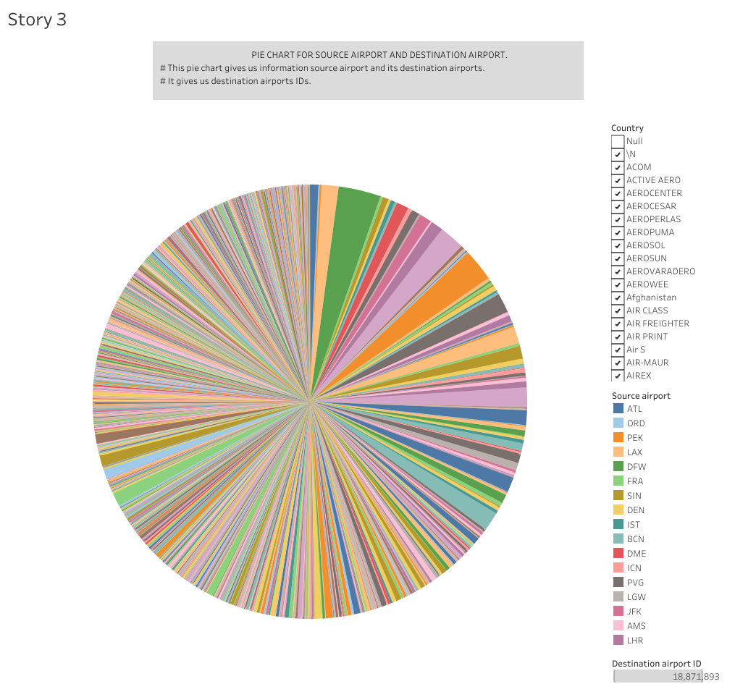

Slide 17
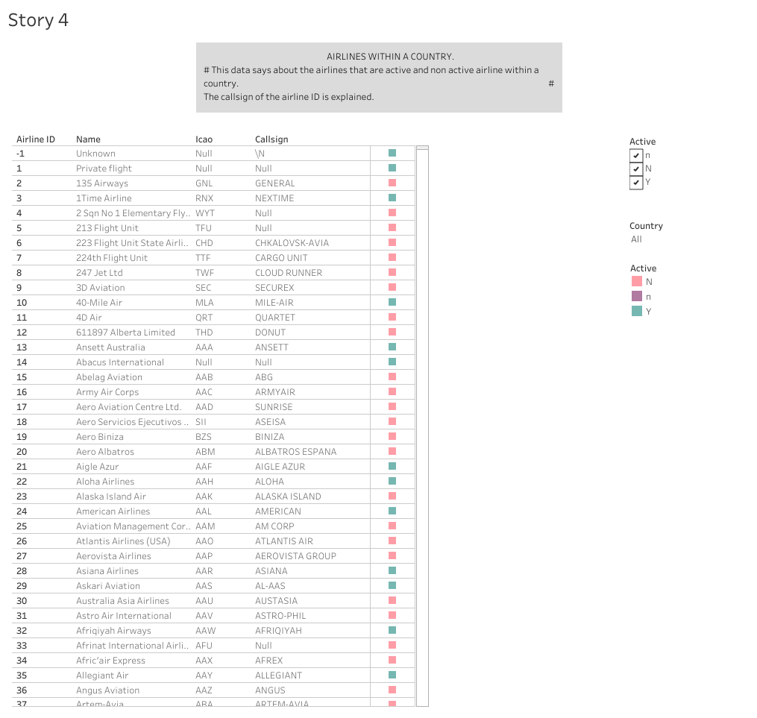

Slide 18
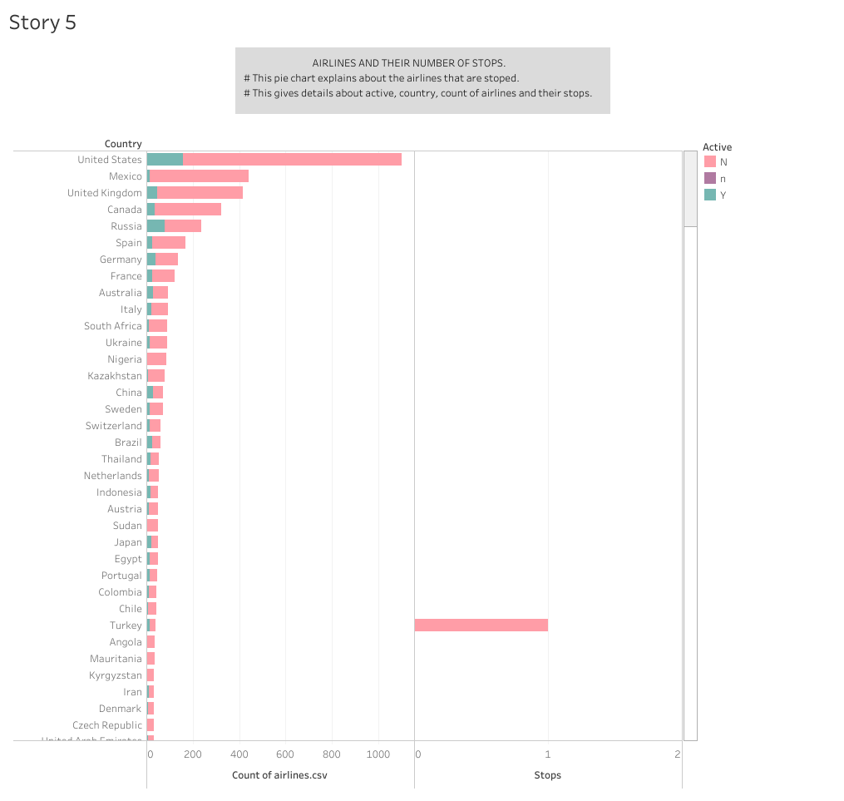

Slide 19
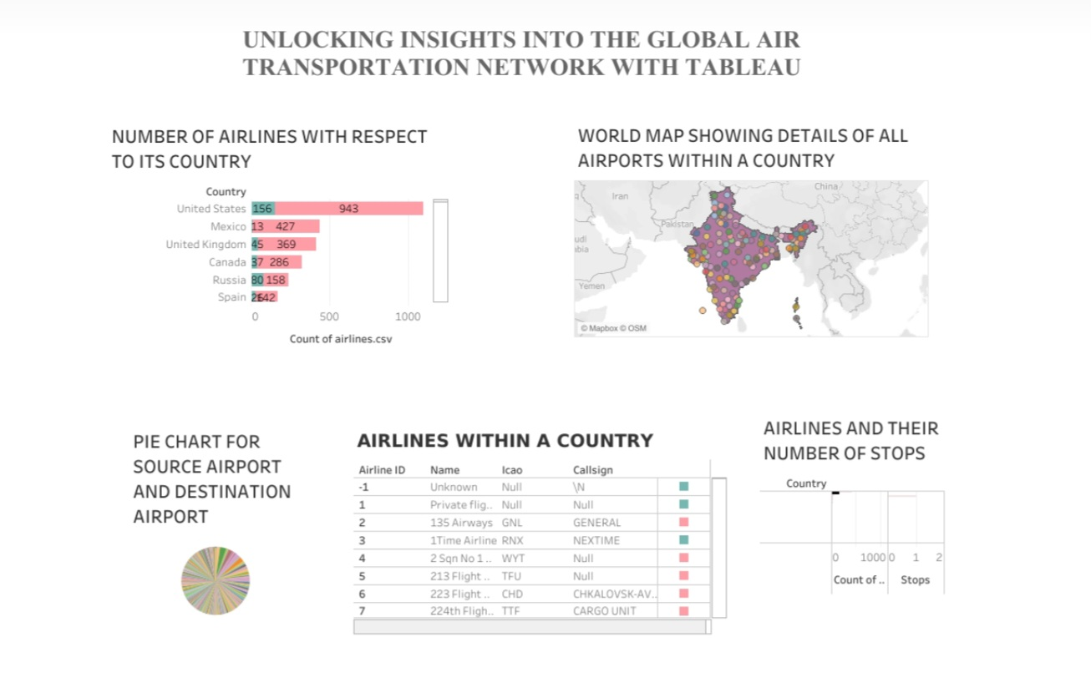
DASHBOARD

Slide 20


